Slide 1

Website Training 2017 - 2018
Chelsey Berry
Website Training Registration: https://goo.gl/forms/FbO3rUpXOFH65gjg1

Slide 2

Double Click on the Google Chrome icon on your desktop

Slide 3
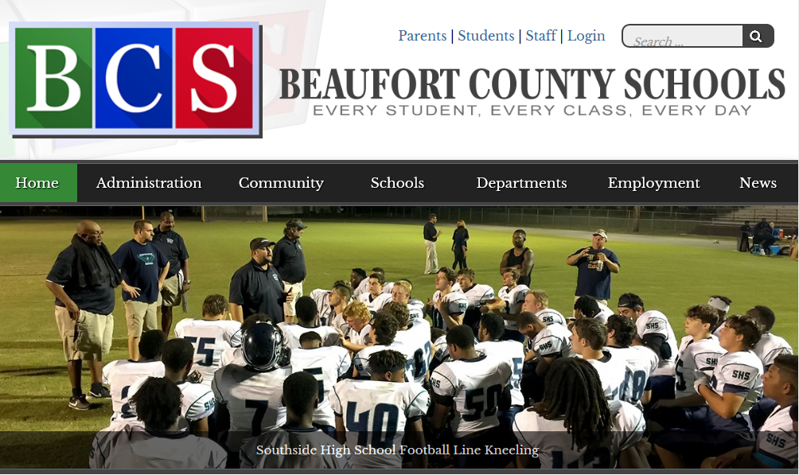
Click on the Beaufort County Schools Tab (1st one)
Once you have clicked on the BCS tab, click on LOGIN.

Slide 4
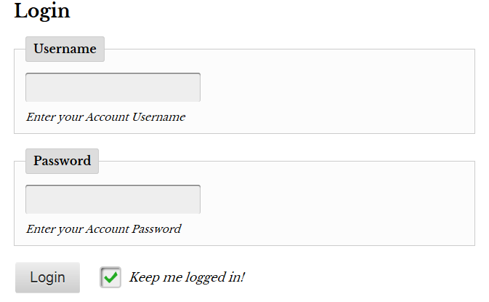

Once you have clicked on LOGIN, you are going to enter your username and password and click LOGIN.
Your username and password are the same as when you login to your teacher computer. It is not your full email!

Slide 5
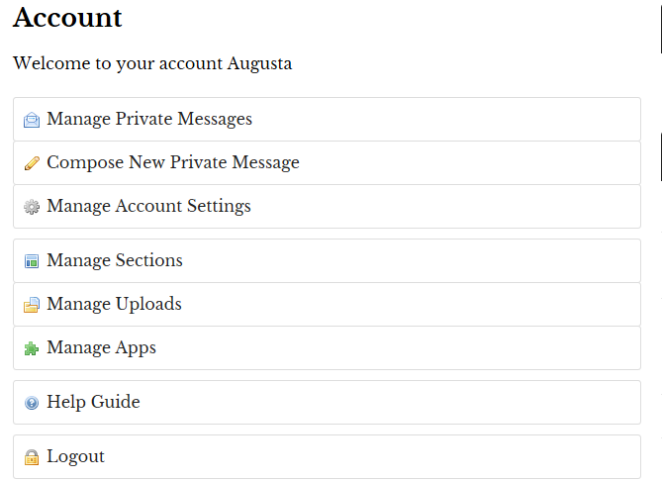
Once you have clicked LOGIN, you will see a welcome message and a list of account options. CLICK on MANAGE SECTIONS

Slide 6
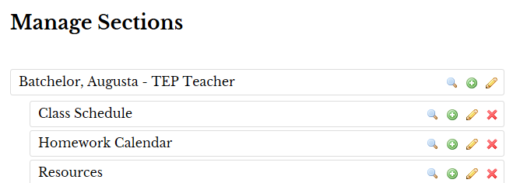

Once you have CLICKED on MANAGE SECTIONS, you will see 4 sections. Your Bio Section (named for you and your position, Class Schedule, Homework Calendar, and Resources.
The first section that we are going to go over today is the Bio Section. The Bio Section is the section that has your name and position. CLICK on the edit icon (pencil) to get started.

Slide 7
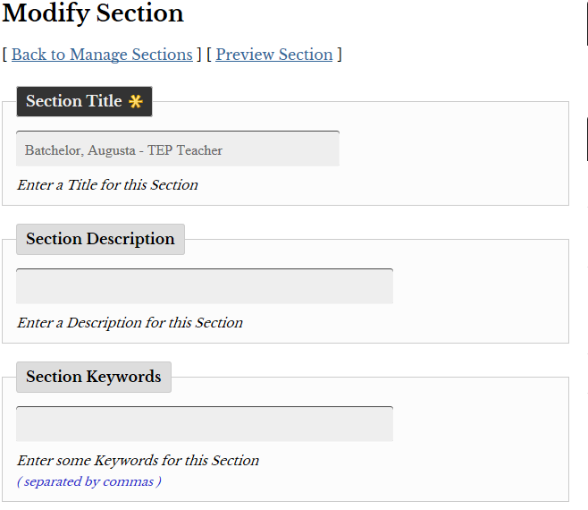

Once you have CLICKED on the edit (pencil) icon, you can begin to modify your information. Make sure that your name and position is spelled and labeled correctly.

Slide 8
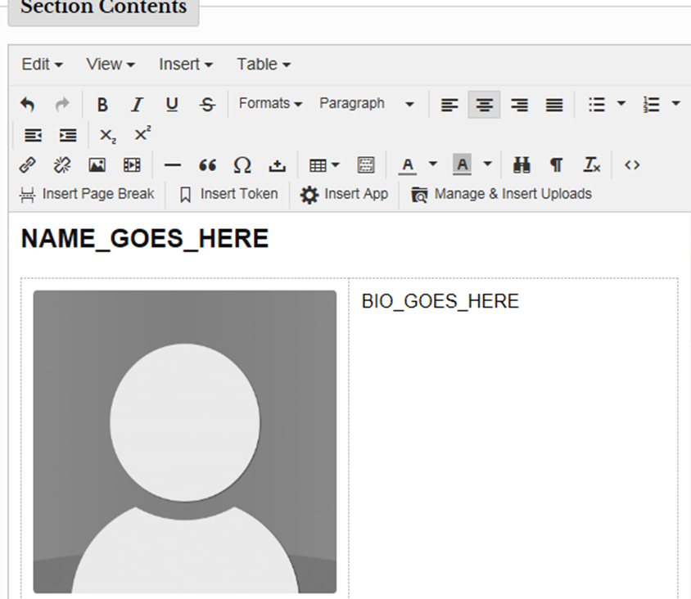
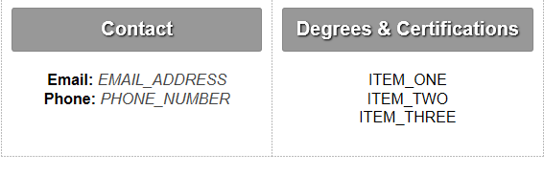
After making sure that your name and position are labeled correctly, you will scroll down to the SECTION CONTENTS. In the SECTION CONTENTS, you will see a Bio Layout Template that has already been chosen for you.
This information is completely editable. You will edit your name, write a short bio, add contact information, and you can edit the degrees and certifications section also.
If you do not want a certain section you can edit the section to fit your needs.
* THIS MAY BE ALREADY DONE FOR YOU. A LOT OF LAST YEAR’S INFORMATION WAS IMPORTED IN. IF THIS IS THE CASE, PLEASE GO BACK TO THE TOP OF THE PAGE AND CLICK BACK TO MANAGE SECTIONS AND GO TO SLIDE 25

Slide 9
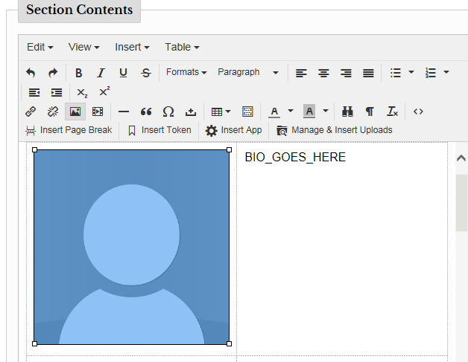
After editing the information for your Bio Section, you will need to choose and upload a professional picture to add to your section.
The first thing that you will need to do is to CLICK on the silhouette. It will then turn blue.

Slide 10
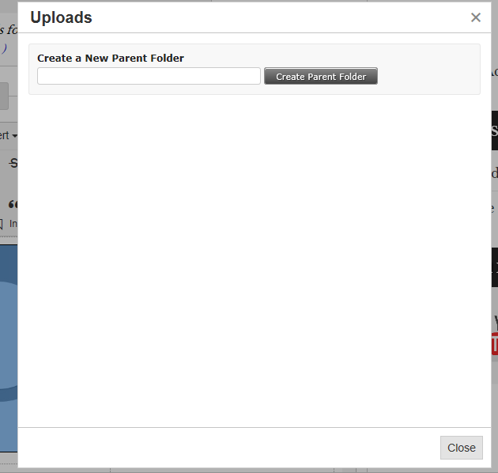

After you have CLICKED on the SILHUOTTE, you will need to create a NEW PARENT FOLDER. You can name this folder anything that you want.
When you have typed in a name to call your folder, CLICK CREATE PARENT FOLDER.

Slide 11
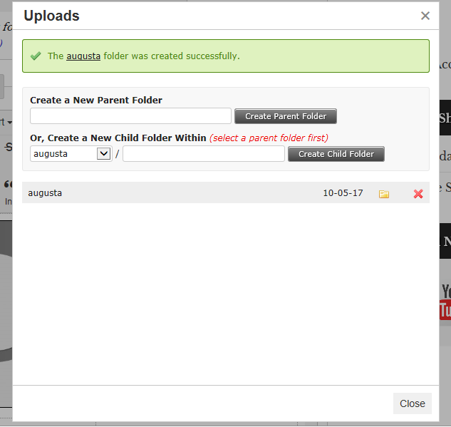
After you have created a PARENT FOLDER, you will click on the YELLOW FOLDER that represents the folder that you have created.

Slide 12
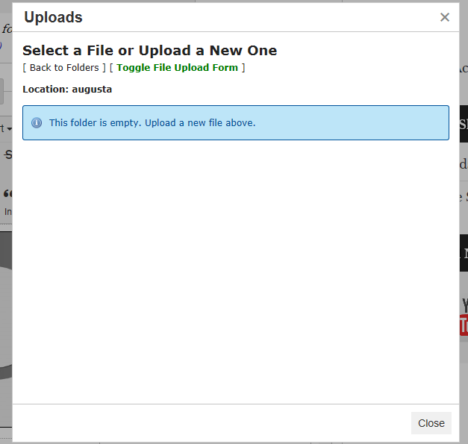
Once you have CLICKED on the YELLOW FOLDER, you will then CLICK on TOGGLE FILE UPLOAD FORM. This is how you will browse your computer to upload an image.

Slide 13
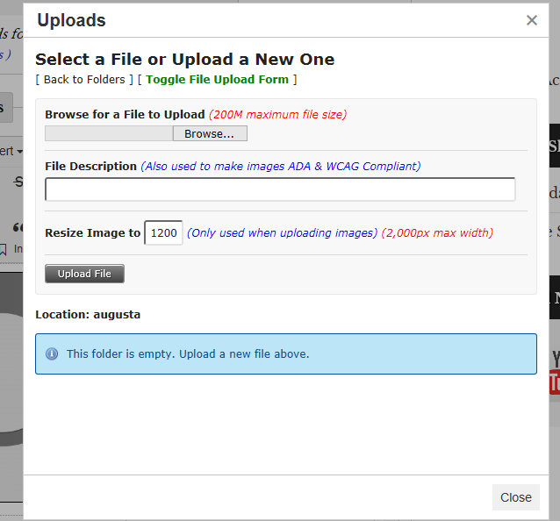
After you have CLICKED on TOGGLE FILE UPLOAD FORM, you will then browse for a FILE TO UPLOAD by clicking BROWSE.

Slide 14
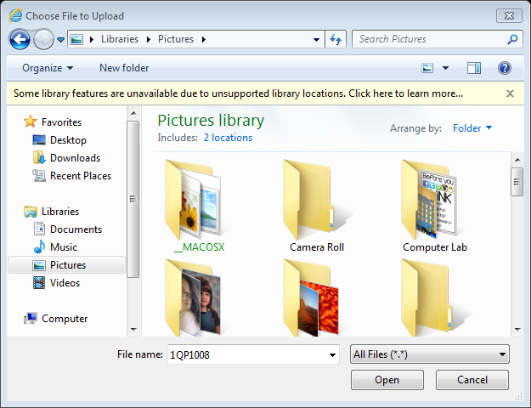
You will then choose a photo or professional headshot that you would like to use for your Bio from your computer and then CLICK OPEN.

Slide 15
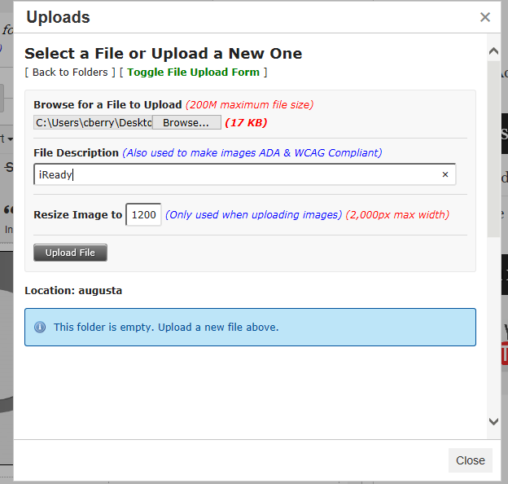
After selecting and opening the photo of your choice, the destination will appear in the box beside the BROWSE button. You will then enter a FILE DESCRIPTION, and CLICK UPLOAD FILE.

Slide 16
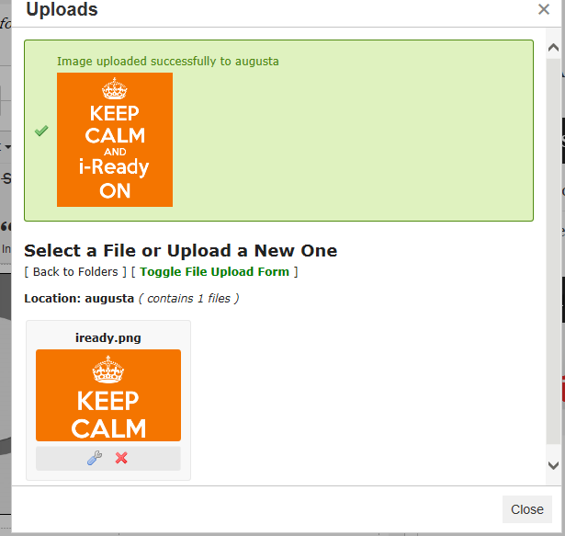
When the file is successfully uploaded, it will appear at the top of the box under the word UPLOADS. You will then click CLOSE.

Slide 17

After closing the upload box, you will automatically return to your Bio Layout/Section Contents.
You will then CLICK on your silhouette, and then click on MANAGE & INSERT UPLOADS.

Slide 18
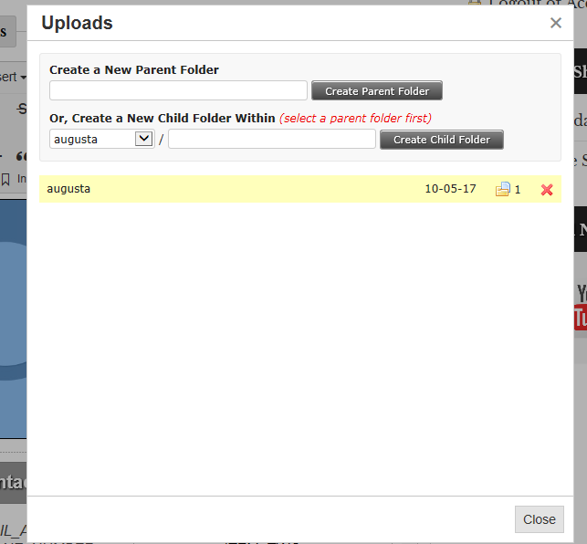
After CLICKING on MANAGE AND INSERT UPLOADS, you will see the PARENT FOLDER that you had created to upload images, but now the PARENT FOLDER will have uploads in it. CLICK on the YELLOW FOLDER.

Slide 19
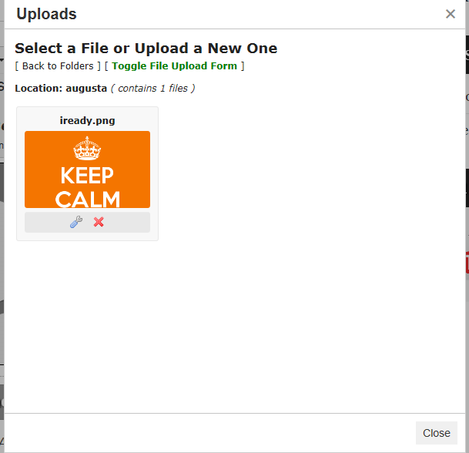

SELECT the file
(by clicking on it) that you uploaded for your professional photo.

Slide 20
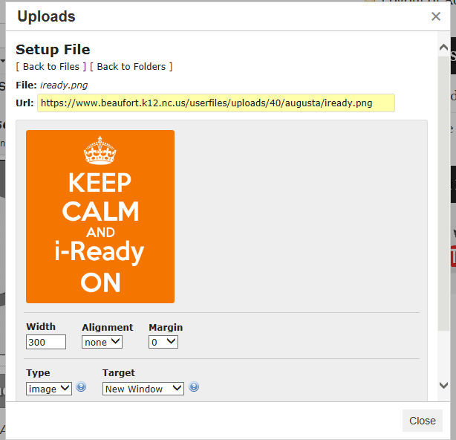
After selecting the file that you added for your professional picture, you can adjust things like the width, alignment, and margin. You can also choose the type for the picture and if you would like the picture to open to a new window (not necessary for this photo).

Slide 21
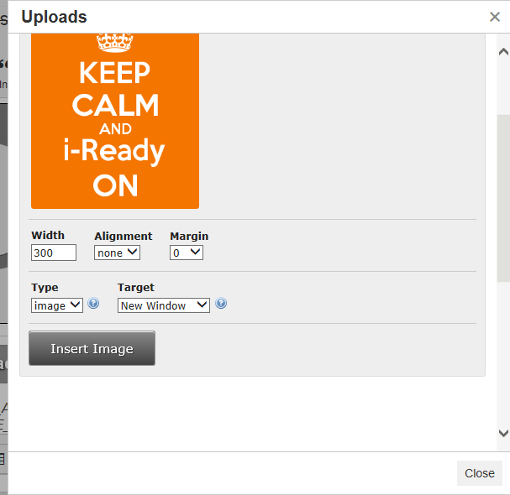
After adjusting the width, alignment, margin, type, and target, (not necessary) you can CLICK INSERT IMAGE.

Slide 22
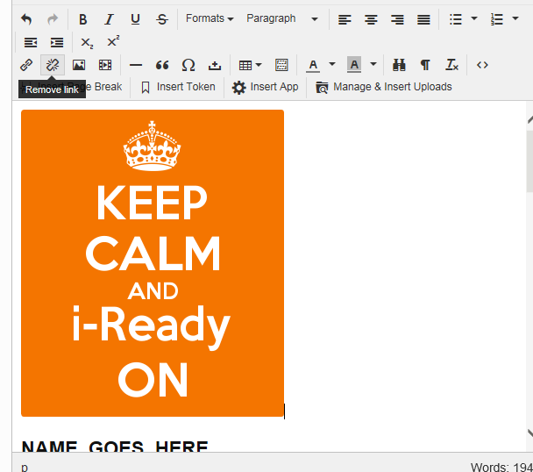
Picture inserted into Bio Layout.

Slide 23
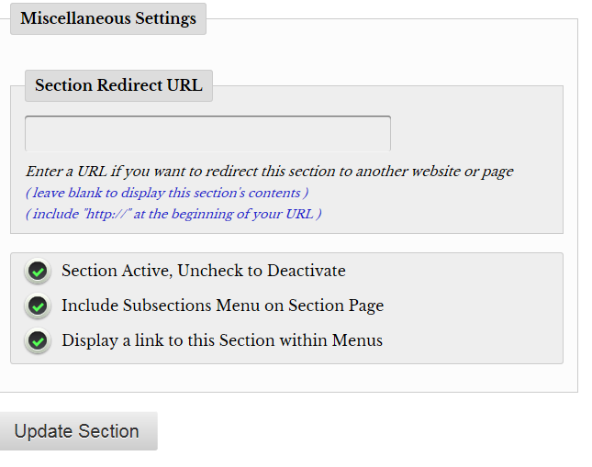
After uploading your image, you will scroll down to the bottom of the page. Make sure all circles are checked and UPDATE SECTION.

Slide 24
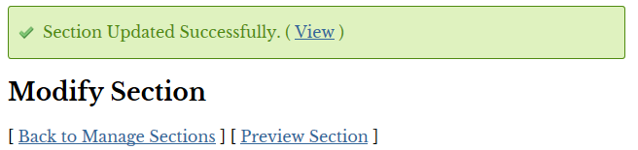
After you have updated your section successfully, you will go BACK TO MANAGE SECTIONS.

Slide 25
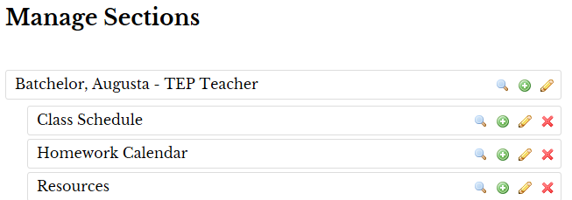
After you have CLICKED on MANAGE SECTIONS, you will now choose to edit (pencil) the section titled CLASS SCHEDULE.

Slide 26
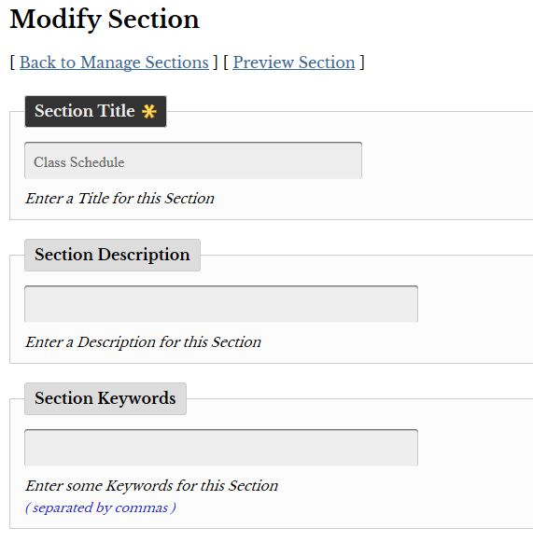
After CLICKING on the pencil (edit), you can modify the section title if you would like, add a section description or section keywords. This is unnecessary, but always an option.

Slide 27
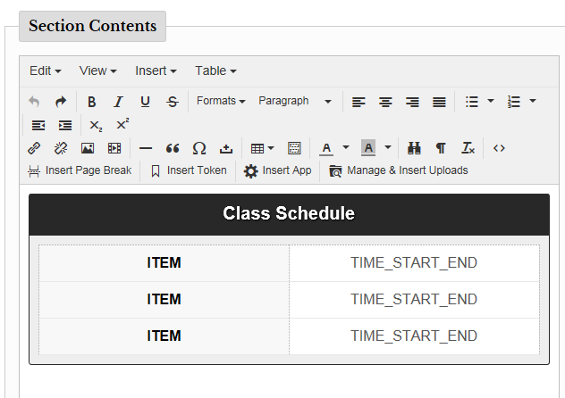

If you scroll down to the bottom of the page, you will see the SECTION CONTENTS In the SECTION CONTENTS, you will see a schedule template already in place for you. You may edit the schedule template (adding rows, columns, deleting rows and columns, deleting table) or replace the template and add your own.
To replace the schedule template, you will need to go to EDIT, SELECT ALL and DELETE the current schedule. After the schedule is deleted, you may type your schedule or upload a picture of your schedule by using the MANAGE AND INSERT UPLOADS option. Refer to slides 9 – 16.
Editing Tools for Table

Slide 28
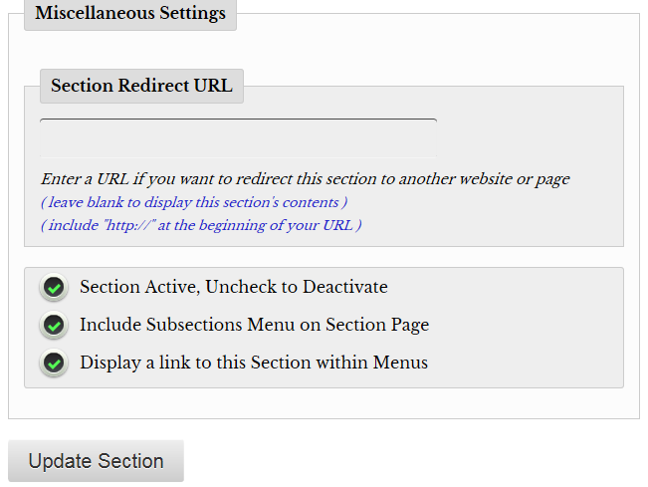
After you have edited or inserted your schedule, you will scroll down and make sure all circles are checked. You will then CLICK UPDATE SECTION

Slide 29

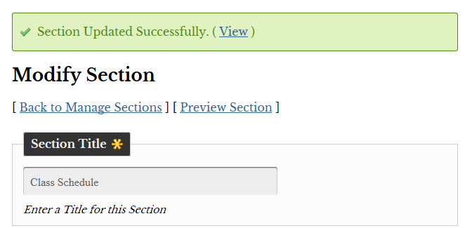


Slide 30
Homework Calendar

Slide 31
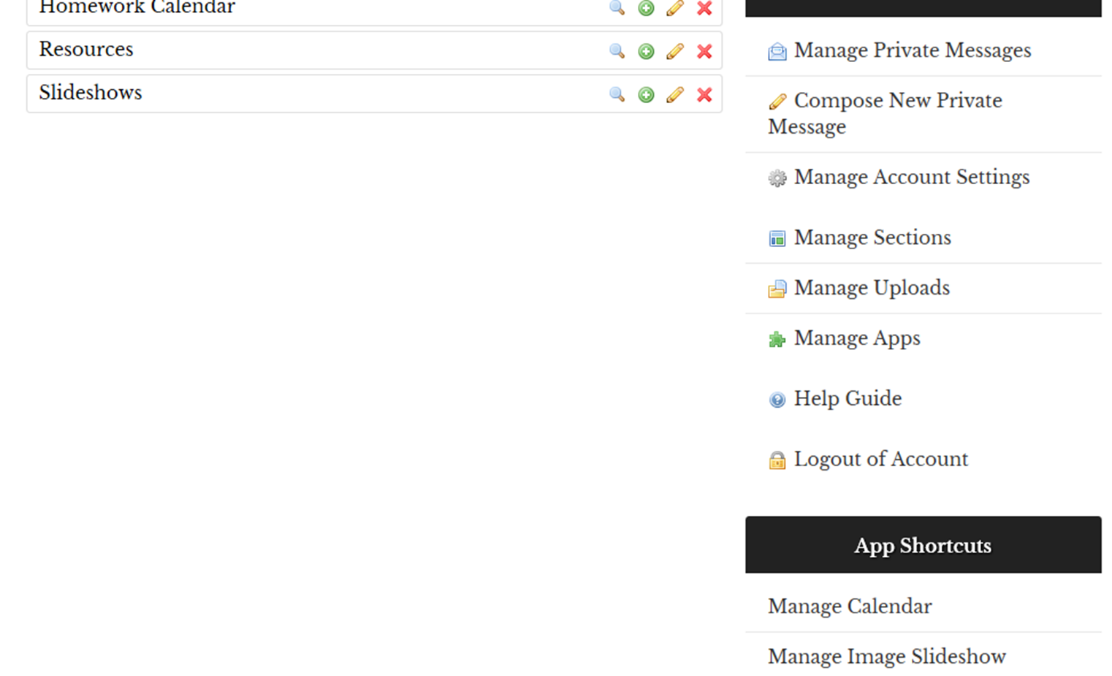

After clicking on MANAGE SECTIONS, you will then scroll down to MANAGE APPS and CLICK on MANAGE CALENDAR

Slide 32
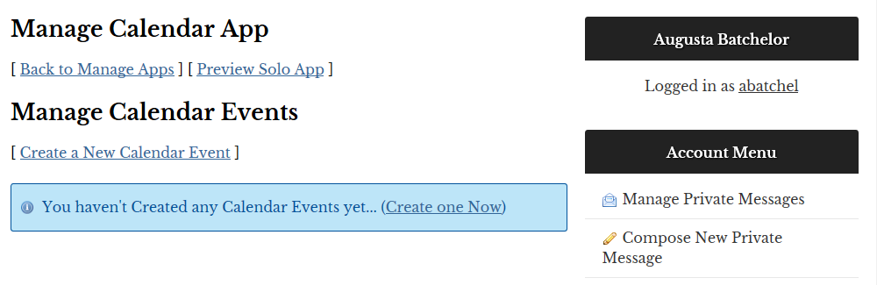
After clicking on MANAGE CALENDAR, you will then CREATE A NEW CALENDAR EVENT.

Slide 33
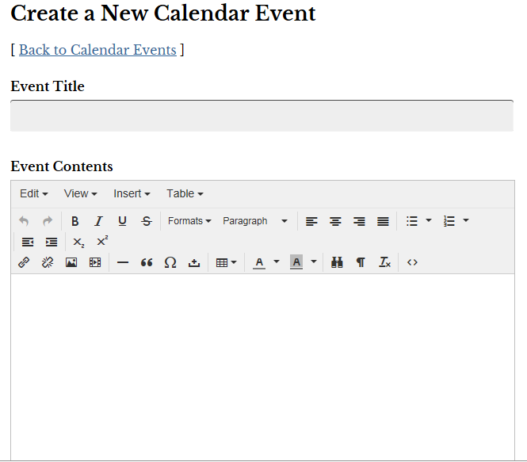
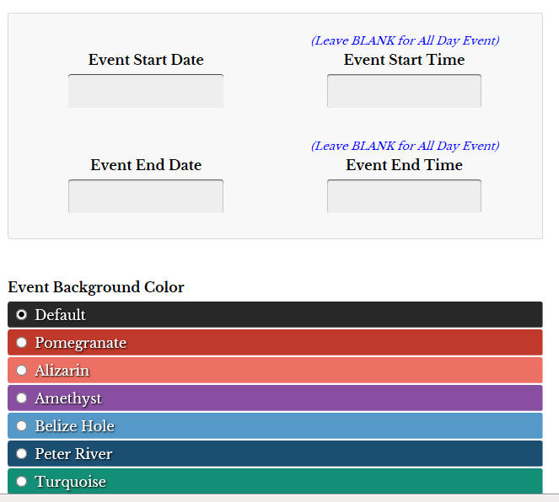
After you have created a NEW CALENDAR EVENT, you will give your event a title, choose the events start date and time and event end date and time. You can also choose a color that you want your event to appear in.

Slide 34
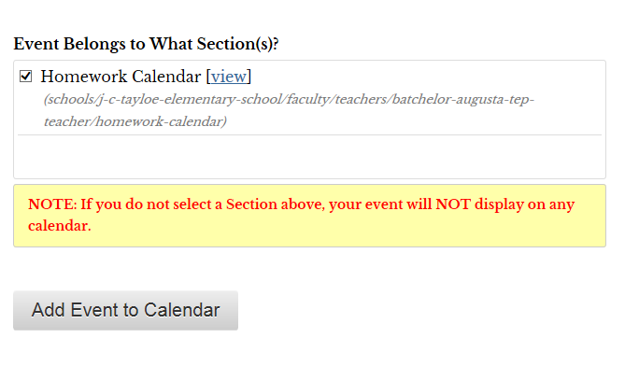
Make sure that the box beside the Homework Calendar is checked. If it is checked you may now ADD EVENT TO CALENDAR.

Slide 35
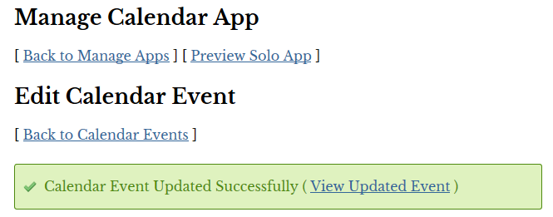
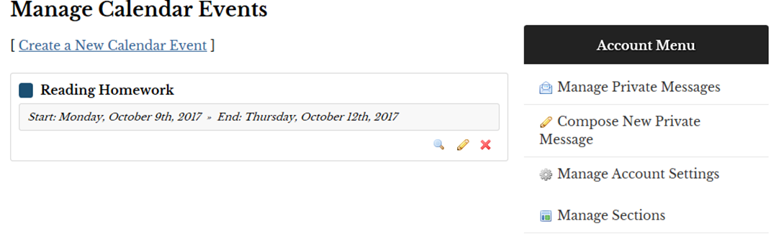

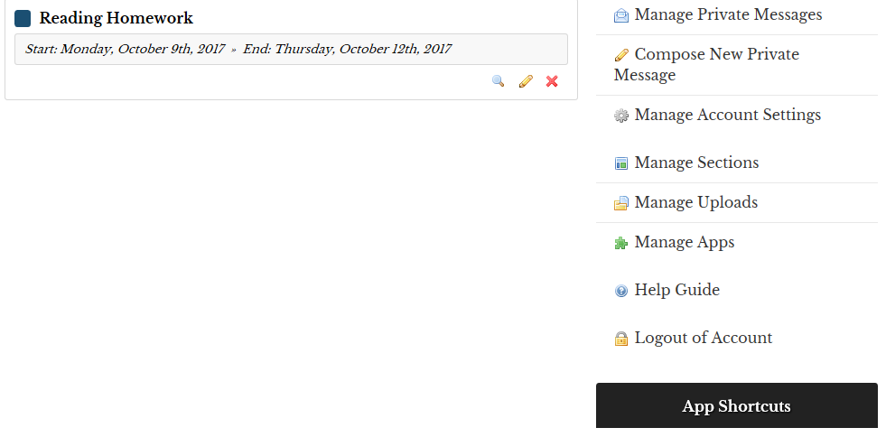

After your CALENDAR EVENT has been UPDATED SUCCESSFULLY, you can VIEW UPDATED EVENT and then return to MANAGE SECTIONS.

Slide 36
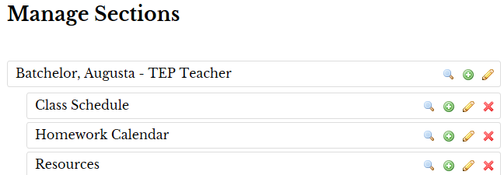
After you have returned to MANAGE SECTIONS, you are going to choose HOMEWORK CALENDAR and view (magnifying glass). A new tab or window will open for you to view the calendar.

Slide 37
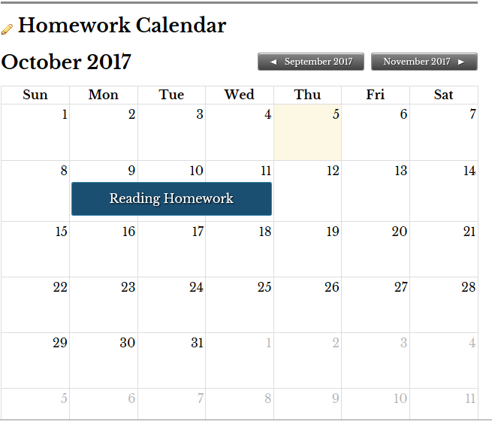
Once the window or new tab opens your event(s) will appear on your homework calendar. After viewing, you will then close out of the window or tab.

Slide 38
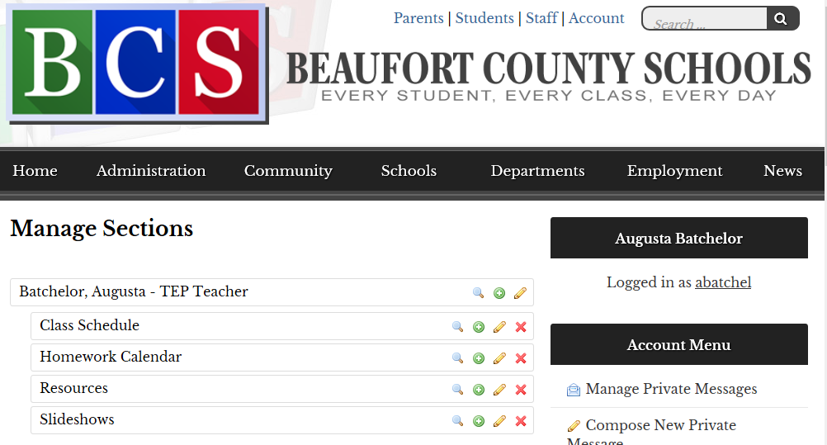
After you have closed the homework calendar window, you will be taken back to MANAGE SECTIONS. This time you will look for the RESOURCES section and choose edit (the pencil)

Slide 39
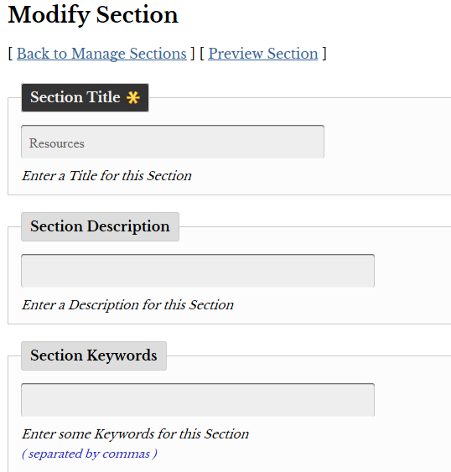
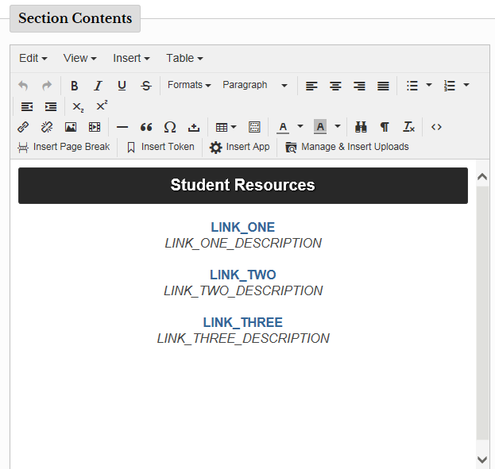
After CLICKING on the edit feature (pencil) for the Resource section, you can begin modifying your SECTION TITLE. In your SECTION CONTENTS you have a resources template already in place.

Slide 40
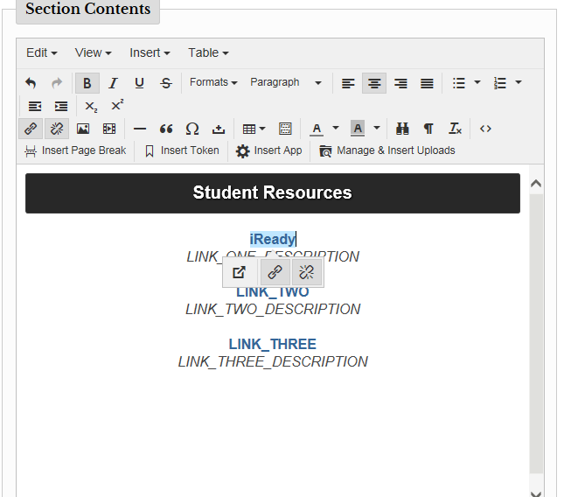
For your STUDENT RESOURCES TEMPLATE you have 3 resources that you can add to your section. Each link is editable. You will type the name of the link. For example iReady, Ren Place. When you have finished typing the link, an option to link the account to a website or URL will appear.

Slide 41


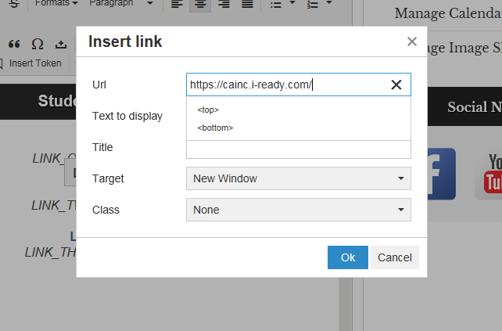
After you have clicked on the LINK ICON, you will copy and paste the link to the website of your choice. You will then CLICK OK.

Slide 42
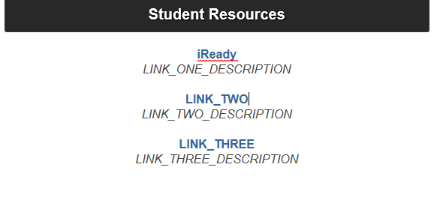
Now the name of the link is now linked to the website that it describes. You can also edit the link description.

Slide 43
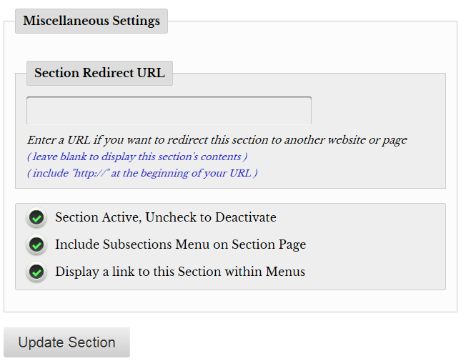
After you have added and linked 3 resources, make sure all 3 circles are checked. If they are you will CLICK UPDATE SECTION.

Slide 44
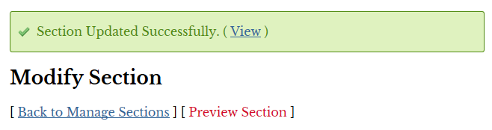
After you have UPDATED your SECTION SUCCESSFULLY, you can either view your section to make sure that it looks the way you want or CLICK BACK TO MANAGE SECTIONS.
If you choose to view your section, a new window or tab will open. If everything looks the way you want it to, close the window or tab and CLICK BACK TO MANAGE SECTIONS.

Slide 45
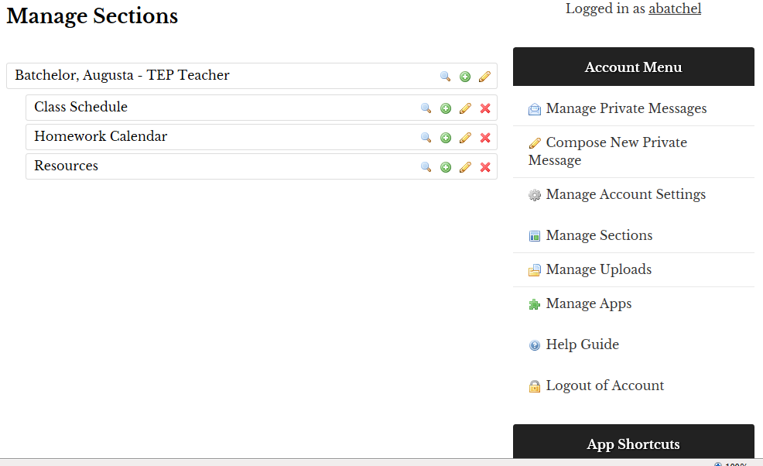
After you have returned to MANAGE SECTIONS, you can LOGOUT OF ACCOUNT

Slide 46


Important Things to Know
View Add Sub Edit Delete
Subsection

Slide 47
Website Training 2017-2018 Feedback Form
https://goo.gl/forms/CnVOJG42gCQP5a4d2

