Slide 1
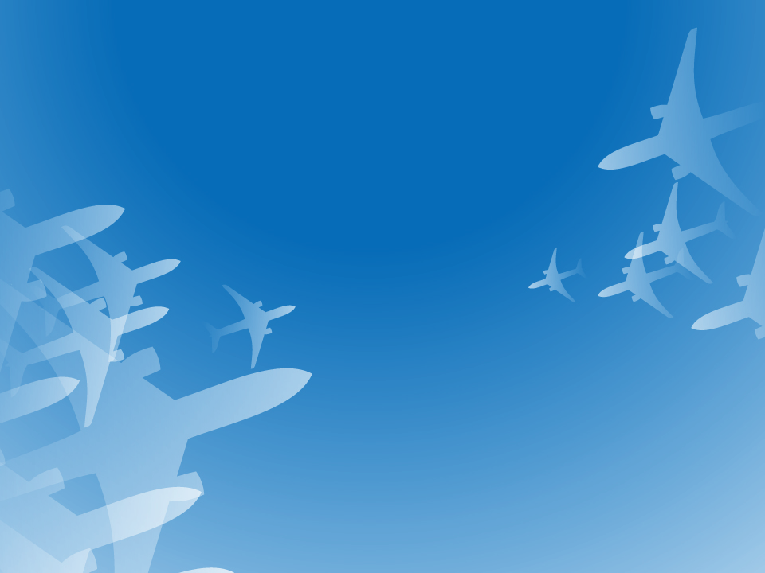
Ancient Flight

Slide 2
How much information do you already know about this topic area?
Expert – I have done a lot of learning in this area already.
Above average – I have learned some information about this topic.
Moderate – I know a little about this topic.
Rookie – I am a blank slate…but ready to learn!
0
0
0
0
AS100-C1L1:LQ1

Slide 3
Which of the following demonstrates dynamic lift?
The pilot angles the wings of the plane up against the wind causing lift
The pilot angles the wings to make air flow faster over the top
The pilot maintains constant pressure on the wings not letting the pressure drop
The pilot angles the wings of the plane down with the wind causing lift
AS100-C1L1:LQ2

Slide 4
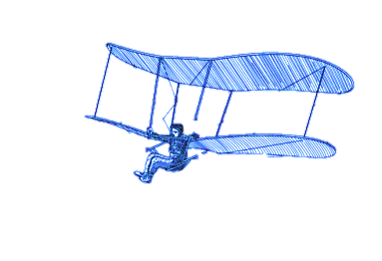
Chapter Overview
Lesson 1: Ancient Flight
Lesson 2: The Early Days of Flight
Lesson 3: The Wright Brothers Take Off
Lesson 4: Pioneers of Flight

Slide 5
Lesson Overview
How humans tried to fly in ancient times
Key aviation devices created during ancient times
Why machines don’t fly the way birds do

Slide 6
Vocabulary Questions Slide Index (Part 1 of 2)
Click any link below to go directly to polling that question.
The act of passing through the air on wings
A device intended to slow free fall from an aircraft or another high point
A light framework covered with paper or cloth, provided with a balancing tail, designed to be flown in the air
An explosive powder made of potassium nitrate, charcoal, and sulfur, used to shoot projectiles from guns
A large, cylindrical object that moves very fast by forcing burning gases out one end of the tube
Click here to return to this index.

Slide 7
Vocabulary Questions Slide Index (Part 2 of 2)
Click any link below to go directly to polling that question.
Unverified story handed down from earlier times
An aircraft that gets its lift from spinning blades
Designing an aircraft to reduce resistance to motion through the air
A light aircraft without an engine, designed to glide after being towed aloft or launched from a catapult
An aircraft designed to get its upward and forward motion from flapping wing
Click here to return to this index.

Slide 8
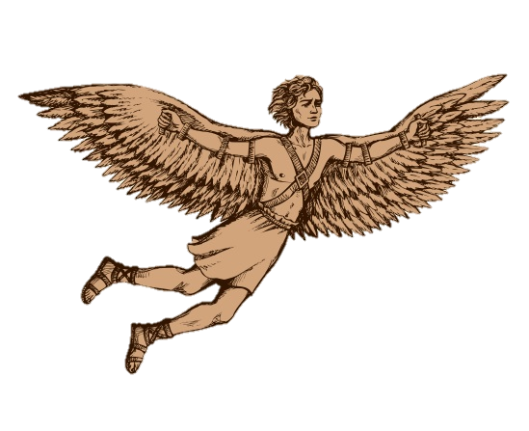
Quick Write
Why do you think the idea of flight is so appealing to people? Does it appeal to you? Why?
(Note to teacher: Click the Show/Hide Response Display Button)
Photo courtesy of Shutterstock

Slide 9
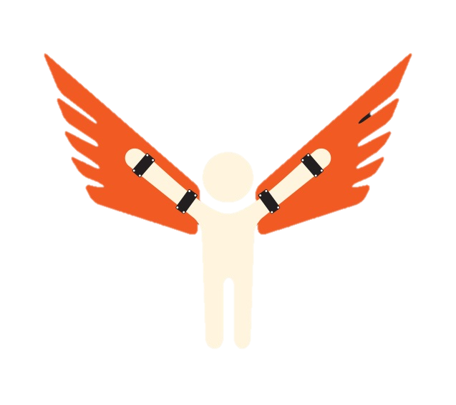
How Humans Tried to Fly in Ancient Times
People dreamed of taking flight for thousands of years
The first stories of flight attempts include strange details
Early inventors made hard landings, resulting in injury or death
Photo courtesy of Shutterstock

Slide 10
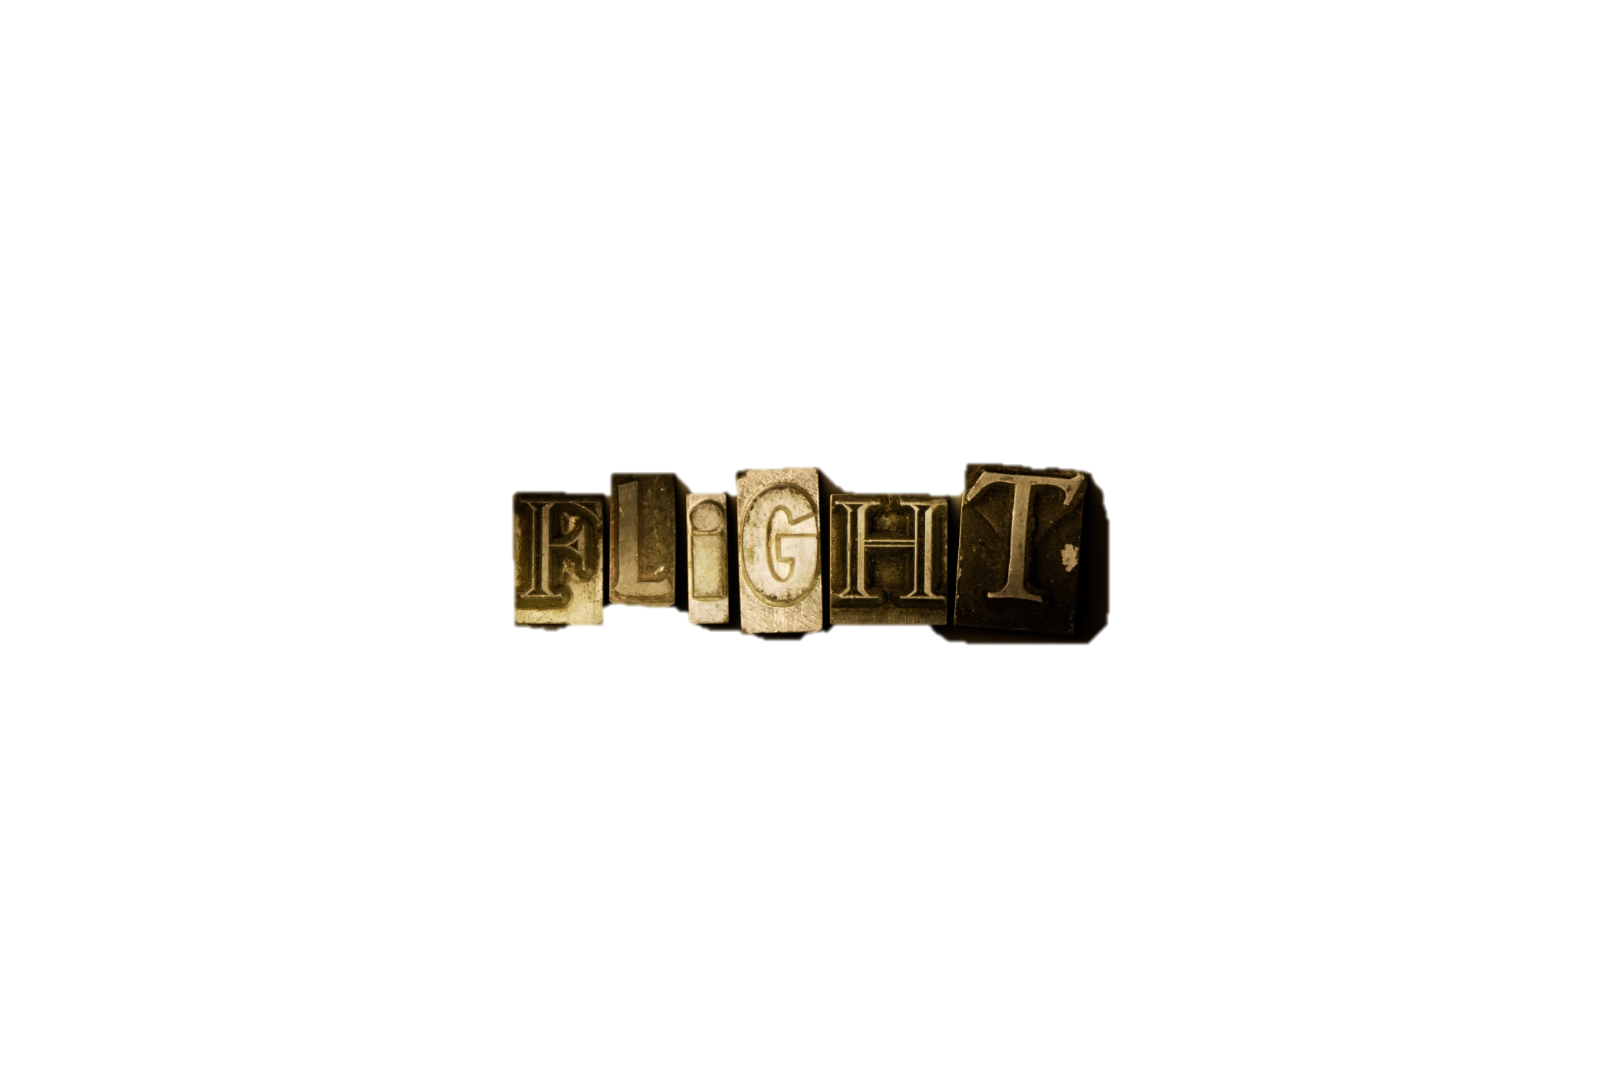
How Humans Tried to Fly in Ancient Times
Armen Firman
Credited with the first human attempt to fly in AD 852
He put on a huge cloak and jumped from a tower
His attempt resulting in death
Photo courtesy of Shutterstock

Slide 11
What did early inventors use to make wings?
Wax
Cloth
Kindling
Feathers
AS100-C1L1:LQ3

Slide 12
Who is credited as the first known human to attempt to fly?
Icarus
Daedalus
King Minos
Armen Firman
AS100-C1L1:LQ4

Slide 13
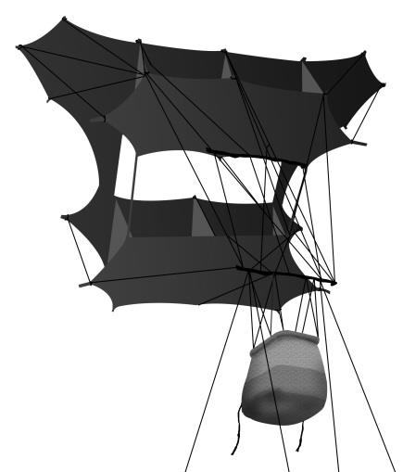
Key Aviation Devices Created During Ancient Times
Chinese Kites
Invented around 1000 BC
Among the first man-made devices to take flight
Chinese soldiers would attach to kites to observe enemy actions
Photo courtesy of Shutterstock

Slide 14
Activity 1: Build and Fly a Kite
Follow the instructions to build a kite
Take it outside and see if you can make it fly
Be creative and experiment with your kite design to see how it will fly

Slide 15
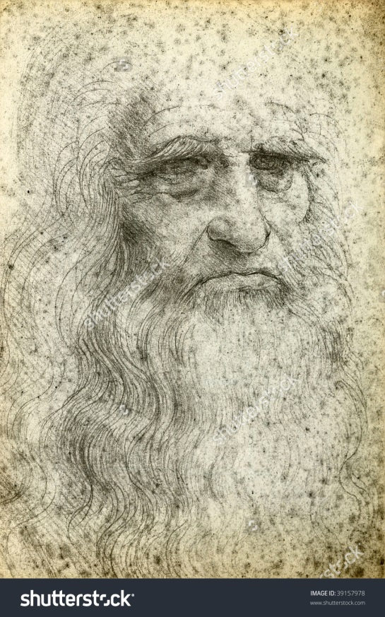
Key Aviation Devices Created During Ancient Times, cont.
Chinese gunpowder and rockets
Gunpowder was invented in AD 800s
Rockets used mostly for celebrations
A parachute and a helicopter
Da Vinci produced the first known designs
Photo courtesy of Shutterstock

Slide 16
Activity 2: Design a Parachute
Design and build a parachute that will carry a pencil
Test out the flying abilities of your parachute
Answer the questions

Slide 17
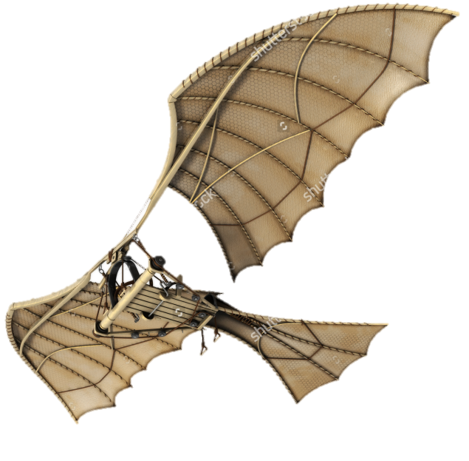
Gliders
First aircraft with directional control
DaVinci experimented with flapping-wing machines
He intended to mimic the motions of a bird
Giovanni Alfonso Borelli concluded a man’s muscle power was not great enough to lift his weight
Photo courtesy of Shutterstock

Slide 18
What important invention did the Chinese make in AD 800s?
Kites
Ornithopters
Gunpowder
Rockets
AS100-C1L1:LQ5

Slide 19
Which of the following was the first aircraft with directional control?
Glider
Ornithopters
Chinese kite
Helicopter
AS100-C1L1:LQ6

Slide 20
Why Machines Don’t Fly the Way Birds Do
Dr. Paul Fortin explains two phases of bird flight:
Ground phase
Lift phase
Photo courtesy of Shutterstock

Slide 21
How Birds Fly
Birds wings move downward rapidly
The wing tips trace a figure eight as they flap
The downward beat of the wings moves the bird forward as the outer tips push against the air
On the downbeat of the wing, the feathers are pressed together
On the up stroke the feathers open

Slide 22
Activity 3: The Magic of Bird Flight
View the video “The Magic of Bird Flight”
Answer the questions

Slide 23
The Magic of Bird Flight

Slide 24
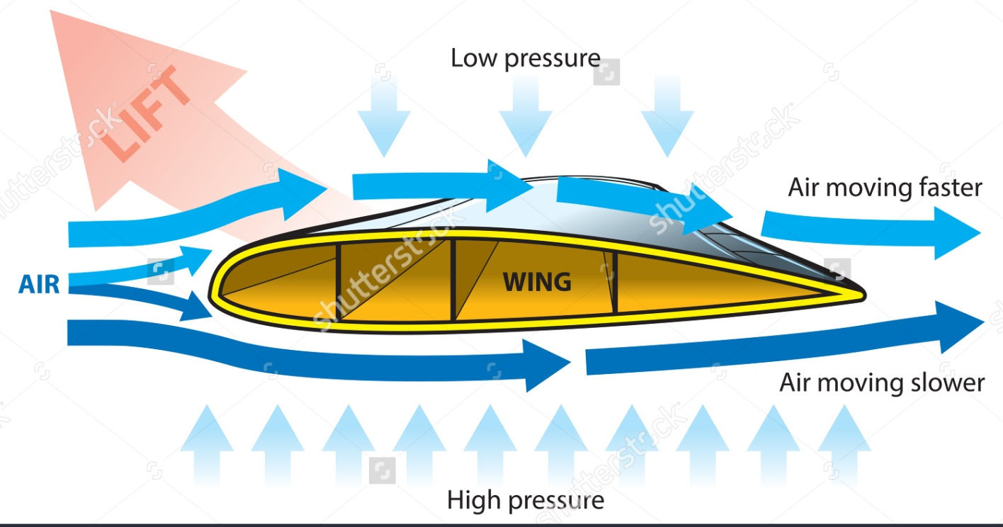
Two Types of Lift
Bernoullian or induced lift
Newtonian or dynamic lift
Photo courtesy of Shutterstock

Slide 25
Bernoullian Lift
Scientist Daniel Bernoulli discovered a relationship between pressure and fluids in motion
When a fluid moves faster the pressure drops
Wings are designed to make air flow faster over their tops
The pressure drops and the wings move upward

Slide 26
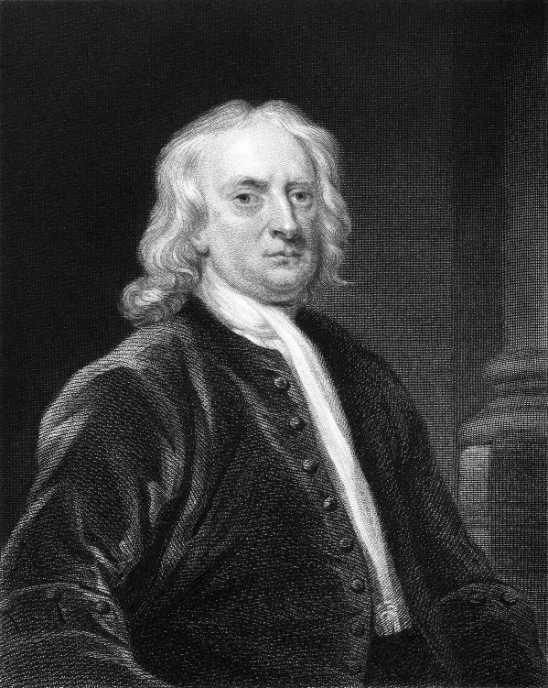
Newtonian Lift
Sir Isaac Newton formulated three laws of motion
Third law states, “For every action, there is an equal and opposite reaction”
When the wing of the plane is angled up against the wind, the action of the wind causes a reaction by the wing
This reaction provides some additional lift
Photo courtesy of Shutterstock

Slide 27
What are the two phases of bird flight?
Ground and lift
Speed and lift
Ground and Speed
Flapping and Speed
AS100-C1L1:LQ7

Slide 28
Which phenomenon is known as the Bernoullian lift?
The air flow over the top of the wing causing the pressure to drop and the wings to move upward
For every action, there is an equal and opposite reaction
The additional lift noticed when a pilot angles the wing of the plane up against an oncoming wind
There is no relationship between pressure and fluids in motion
AS100-C1L1:LQ8

Slide 29
Activity 4: Is Bernoulli’s Principle Worth Two Cents?
Follow the instructions to create an airfoil out of a piece of file folder
Make it “fly” with a source of high velocity wind

Slide 30
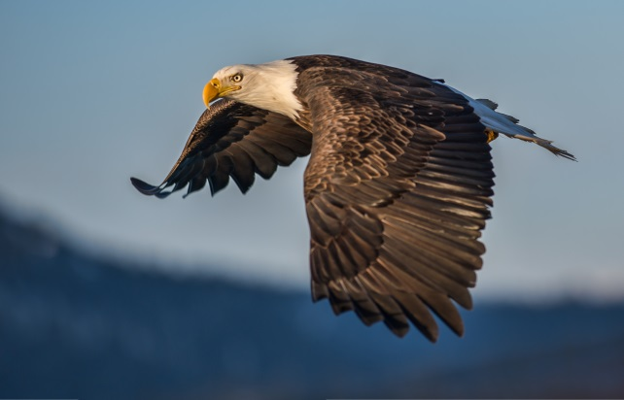
Why Ancient Inventors Tried to Mimic Bird Flight
Flapping wings seemed to be what flight was all about at the beginning
Some thought feathers might possess some lifting power
When people stopped trying to fly as birds it opened the way to success
Photo courtesy of Shutterstock

Slide 31
Summary
How humans tried to fly in ancient times
Key aviation devices created during ancient times
Why machines don’t fly the way birds do

Slide 32
How do you think the attempt at early flight impacted modern day flight?
Note to Instructors:
Click the Show/Hide Response Display Button
AS100-C1L1:LQ9

Slide 33
What is the most interesting thing you learned in this lesson? Why?
Note to Instructors:
Click the Show/Hide Response Display Button
AS100-C1L1:LQ10

Slide 34
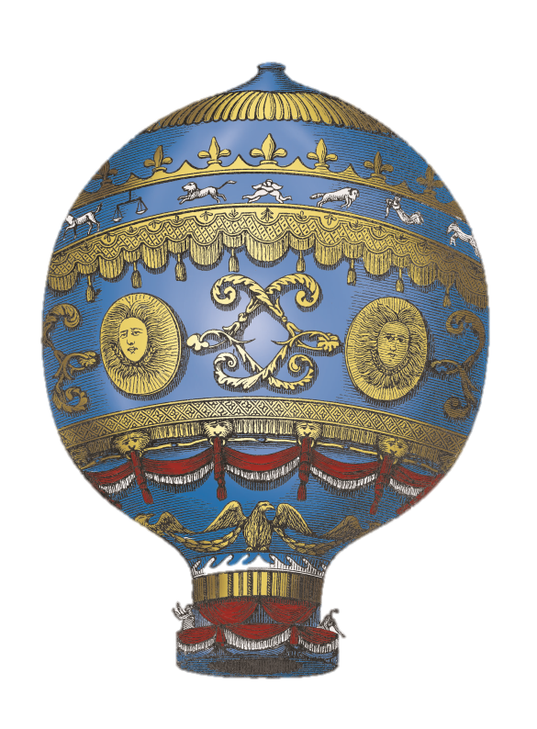
Next….
Done – ancient flight
Next – the early days of flight
Photo courtesy of Shutterstock

Slide 35
Team Assignment
Alpha
Bravo
Charlie
Delta

Slide 36
The act of passing through the air on wings (p. 5)
Kite
Flight
Glide
Parachute
0
0
0
0
AS100-C1L1:VQ1

Slide 37
A device intended to slow free fall from an aircraft or another high point (p. 6)
Glider
Rocket
Parachute
Helicopter
0
0
0
0
AS100-C1L1:VQ2

Slide 38
A light framework covered with paper or cloth, provided with a balancing tail, designed to be flown in the air (p. 6)
Kite
Glider
Ornithopter
Parachute
0
0
0
0
AS100-C1L1:VQ3

Slide 39
An explosive powder made of potassium nitrate, charcoal, and sulfur, used to shoot projectiles from guns (p. 7)
Rocket
Fireworks
Gunpowder
Rocket fuel
0
0
0
0
AS100-C1L1:VQ4

Slide 40
A large, cylindrical object that moves very fast by forcing burning gases out one end of the tube (p. 7)
Kite
Glider
Rocket
Parachute
0
0
0
0
AS100-C1L1:VQ5

Slide 41
Unverified story handed down from earlier times (p. 7)
Myth
Fable
Legend
Fairytale
0
0
0
0
AS100-C1L1:VQ6

Slide 42
An aircraft that gets its lift from spinning blades (p. 7)
Glider
Rocket
Orinthopter
Helicopter
0
0
0
0
AS100-C1L1:VQ7

Slide 43
Designing an aircraft to reduce resistance to motion through the air (p. 8)
Streamlining
Modernizing
Reorganizing
Reforming
0
0
0
0
AS100-C1L1:VQ8

Slide 44
A light aircraft without an engine, designed to glide after being towed aloft or launched from a catapult (p. 9)
Kite
Glider
Helicopter
Orinthopter
0
0
0
0
AS100-C1L1:VQ9

Slide 45
An aircraft designed to get its upward and forward motion from flapping wing (p. 9)
Kite
Glider
Helicopter
Orinthopter
0
0
0
0
AS100-C1L1:VQ10

Slide 46
Leaderboard
Last
Slide
Points | Participant | Points | Participant

Slide 47
Team Scores
Last
Slide
Points | Team | Points | Team

Slide 48
Team MVP
Last
Slide
Points | Team | Participant

Slide 49
Whiteboard
Last
Slide

